Slide 1


————————
EEET2574
Big Data for Engineering
Assignment 3
Team 2
Huynh Van Anh, Nguyen Le Bao Han, Nguyen Thanh Sang,
Lee Wonjun, Nguyen Dang Nhat

Slide 2
Team Introduciton
Huynh Van Anh
Nguyen Le Bao Han
Nguyen Thanh Sang
Data Engineer
&
Analyst
Data Scientist
&
Analyst
Product Manager
Lee Wonjun
Nguyen Dang Nhat
Data Engineer
Data Scientist

Slide 3
Table of Content
————————
Overview
Solution Design
Demonstration
Conclusion

Slide 4

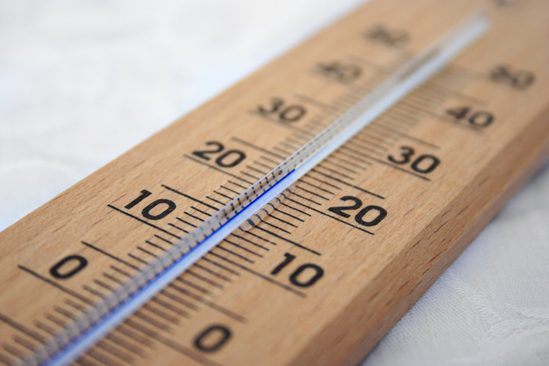


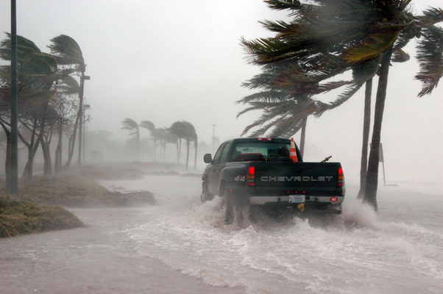
Factors of agriculture
Water
Temperature
Agriculture
Sunlight
Extreme weather

Slide 5


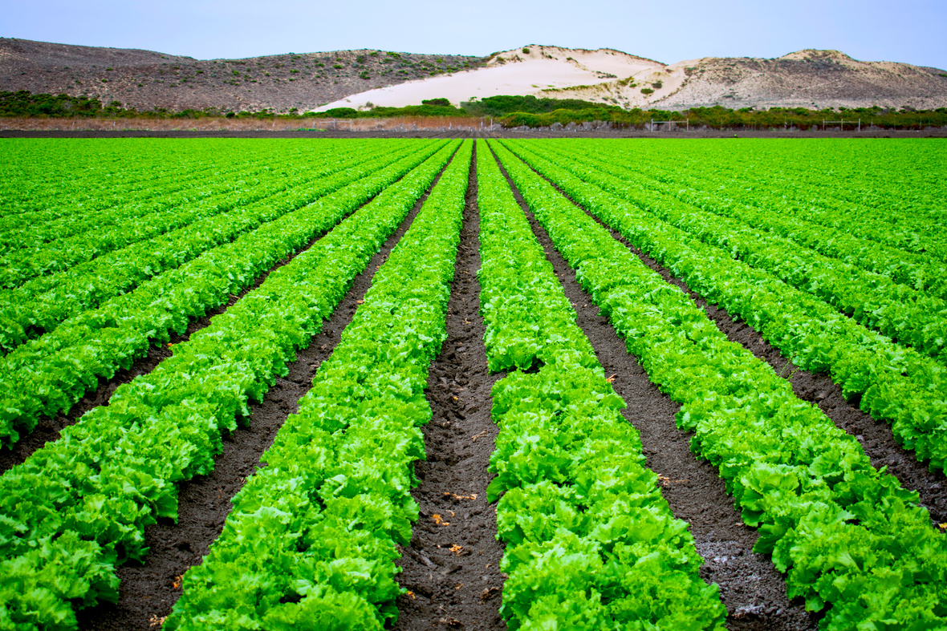
Importance of weather forecast
Fertilization &
Diecese controls
Field work
schedules
Deciding varieties of
crops

Slide 6
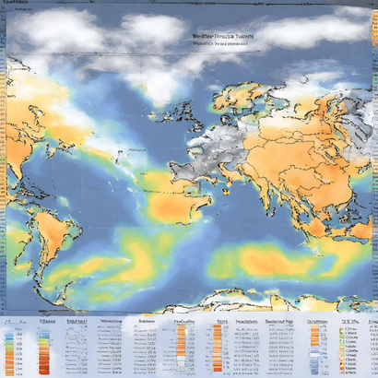



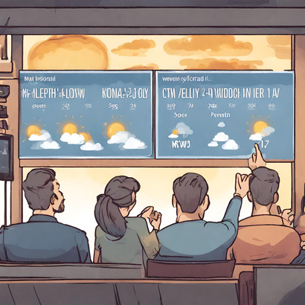
Aim of project
Multi-label classification model of
weather forecasting for agricultural cities
Collecting Data
Train model
Processing real data
Visual forecast

Slide 7
Solution Design

Slide 8


Dataset
Historical Hourly
Weather Data
Current weather data
US Accidents
Streaming data of current
weather from selected
cities
High temporal resolution
data of various weather
attributes
from 2012 to 2017
Car accident dataset of US
from Traffic API with meteorological data
from 2016 to 2023

Slide 9







Technologies
MongoDB
SageMaker
S3
CloudWatch
Kinesis
Quicksight

Slide 10
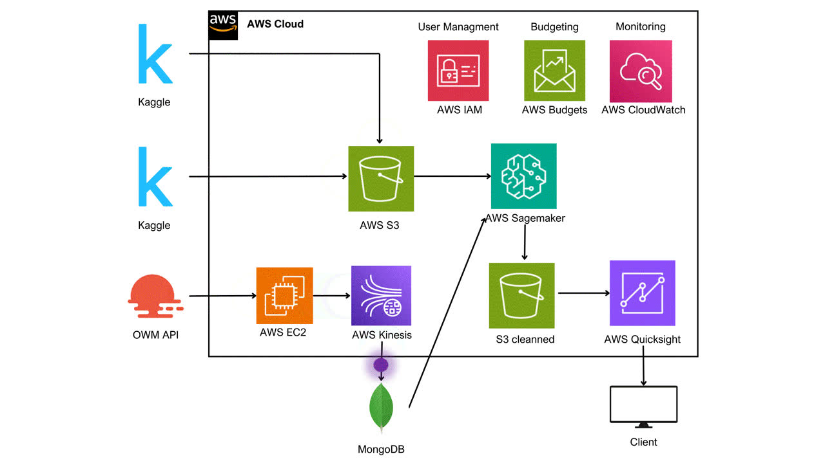
Data Pipeline

Slide 11
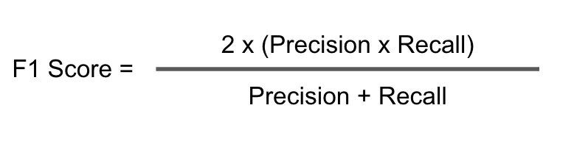
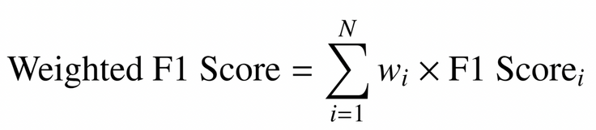
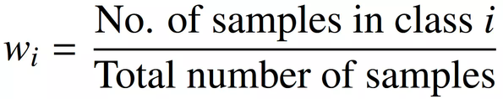
Evaluation metrics
F1 weighted :weighted average of the class-wise F1 scores considering the number of samples in each class.
Majoritiy classes favored
Suitable for imbalanced dataset
Binary classification:
Multi-class classification:
where

Slide 12
Model Training result
Preliminary results:
Model | Score
Random Forest | 0.68
RandomForest with Hyperparamerter tuning | 0.68
Extra Trees | 0.70
Extra Trees with Hyperparameter tuning | 0.70

Slide 13
Demonstration

Slide 14



Conclusion
Conclusion
Limitation
Future work
Trained model that can
predict weather
Can load live API to model
for prediction
Low quality of data
Lack of time &
computing power
More data with better quality
Model trained with better
computing power

Slide 15
Reference
Tigerschiold T (2022) What is Accuracy, Precision, Recall and F1 Score?, labef website, accessed 15 January 2024.https://www.labelf.ai/blog/what-is-accuracy-precision-recall-and-f1-score

Slide 16

Use Big Data
for
Bigger Things!

